Slide 1


INTRODUCTION
TELECOM CHURN ANALYSIS

Slide 2
OBJECTIVE
Utilize predictive insights derived from customer behavior patterns to identify high-risk segments and mitigate attrition through targeted interventions, ultimately enhancing overall retention rates.
Leverage in-depth analysis of demographic, service usage, and geographical trends to uncover root causes of customer churn, enabling organizations to address underlying issues and optimize customer satisfaction effectively.

Slide 3
BUSINESS REQUIREMENT
Create an entire ETL process in a database and a Power BI dashboard to utilize the customer data and to achieve below goals :
Analyze customer data at below levels
  Demographic
  Geographic
  Payment & Account Info
  Services
Study Churner Profile & Identify Areas For Implementing Marketing Campaigns.
Identify a Method to Predicts Future Churners.
Metrics Required :
  Total Customers
  Total Churn & Churn Rate
  New Joiners

Slide 4
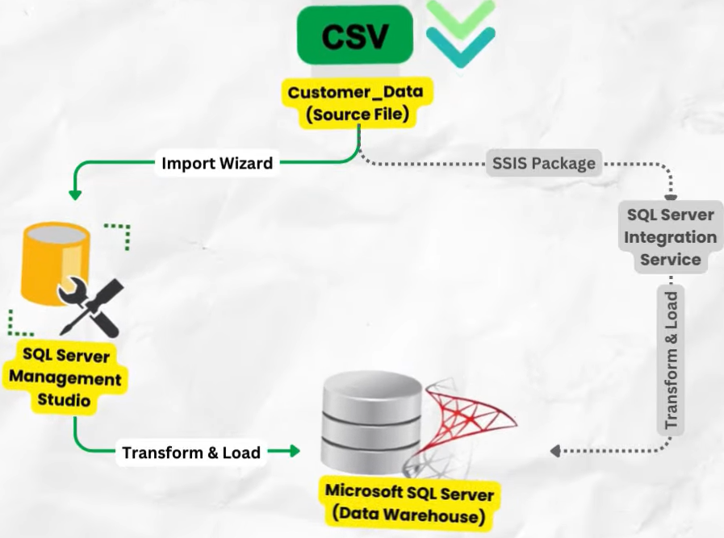
PROBLEM STATEMENTS
ETL Process on SQL Server
Database , Table, View Creation
Power BI Churn – Summary
Data Transformations
Custom Measures
Basic & Advanced Visualization
Data Analysis Approach
Machine Learning Model – Random Forecast
Data Preparation & Processing
Model Building and Evaluation
Prediction on Joiners Data
Power BI Churn Prediction
Churner Profile
Customer at Risk

Slide 5
CHART REQUIREMENTS
KPI :
Total Customers - The aggregate count of all active customers.
New Joiners – It represents the number of customers who have subscribed.
Total Churn – Number of customers who churned
Churn Rate – ( Total churn customer / total customers ) * 100
DEMOGRAPHICS :
Total Churn by Gender
Total Customers & Churn Rate by Age Group
ACCOUNT INFO :
Churn Rate by Payment Method
Churn Rate by Contract
Total Customers & Churn Rate by Tenure Group

Slide 6
CHART REQUIREMENTS
GEOGRAPHIC :
Churn Rate by State ( Top 5 )
CHURN DISTRIBUTION :
Total Churn by Churn Category
SERVICES USED :
Churn Rate by Internet Type
Churn by Services
SLICERS :
Monthly Charge Range
Married

Slide 7
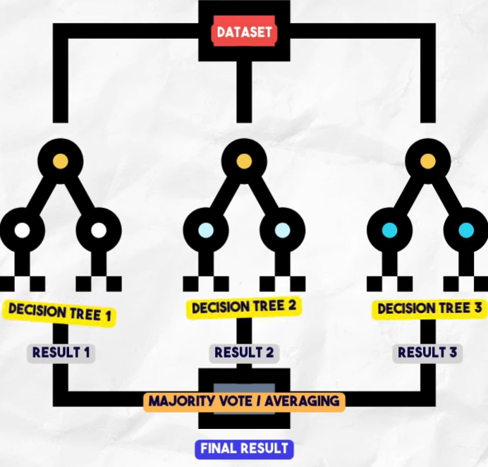
CHURN PREDICTION
MACHINE LEARNING -
It is a branch of artificial intelligence (Al) that enables computers to learn from and make decisions based find patterns in data and improve performance over time as more data is processed.
RANDOM FOREST ALGORITHM -
It is a machine learning algorithm that consists of multiple decision trees. Each decision tree is trained on a random subset of the data and features. The final prediction is made by averaging the predictions (in regression tasks) or taking the majority vote (in classification tasks) from all the trees in the forest.

Slide 8
ANALYSIS AND FINDINGS:
Male customers (64.1%) and regions like Jammu & Kashmir (57.2%) show the highest churn rates, signaling targeted improvement opportunities.
Lack of add-ons like Device Protection Plans (71%) and Online Security (84.6%) drives higher churn.
Fiber-optic users have the highest churn (41.1%), reflecting potential dissatisfaction despite premium offerings.
Month-to-month contracts (46.5%) and mailed payments (37.8%) correlate strongly with higher churn rates.
New customers (<6 months) churn the most (26.4%), underscoring the need for robust onboarding.
Competitive pricing (37%) and dissatisfaction (36%) dominate churn reasons, with additional concerns around pricing and service attitude.
Streaming services and premium support reduce churn, showcasing the value of bundled offerings and quality service.

Slide 9
RECOMMENDATIONS
Target High-Risk Segments:
Focus retention efforts on month-to-month contracts, early tenure customers, and high-churn regions like Jammu & Kashmir.
Enhance Service Offerings:
Boost adoption of services like Device Protection Plans and address Fiber Optic user concerns.
Optimize Payments & Contracts:
Encourage digital payments and long-term plans through incentives.
Improve Onboarding & Experience:
Strengthen onboarding for new customers and address dissatisfaction using feedback.
Focus on Churn Drivers:
Tackle issues like pricing and service dissatisfaction with competitive pricing and better support.
Promote Premium Services:
Highlight benefits of streaming and premium support to retain customers.

Slide 10
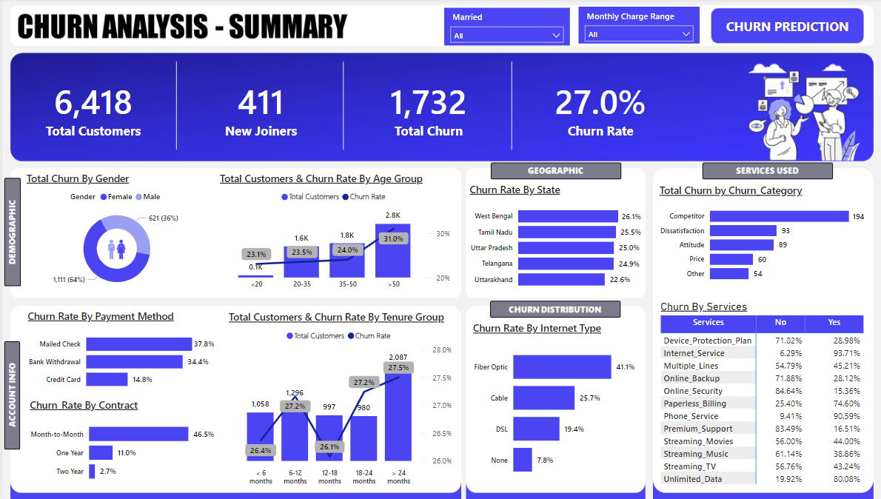
DASHBOARD

Slide 11
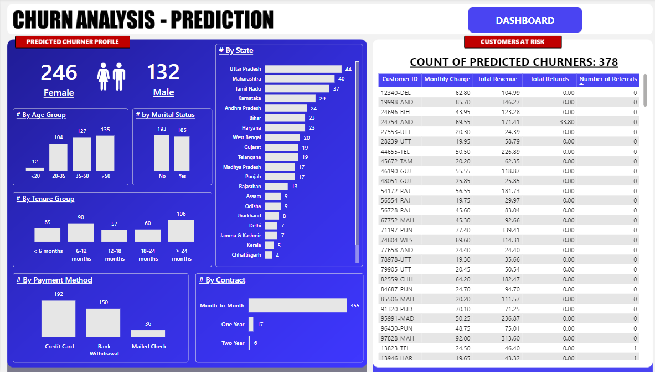
DASHBOARD – CHURN PREDICTION

Slide 12
THANK YOU

